Slide 1
Beyond the threaded programming model on real-time operating systems
E. R. Jellum*, S. Lin†, P. Donovan†, E. Soyer†, F. Shakir†, M. Orlandic*, T. H. Bryne*, M. Lohstroh† and E.A. Lee†
* Norwegian University of Science and Technology
† University of California Berkeley
Norwegian University of Science and Technology
18. January 2023 @ NG-RES, HiPEAC
Contact: erling.r.jellum@ntnu.no
Notes:
Today I will present the following paper which is a result of work performed while I was visiting UC Berkeley last fall.
The paper is about designing embedded systems software using a new programming language called Lingua Franca

Slide 2


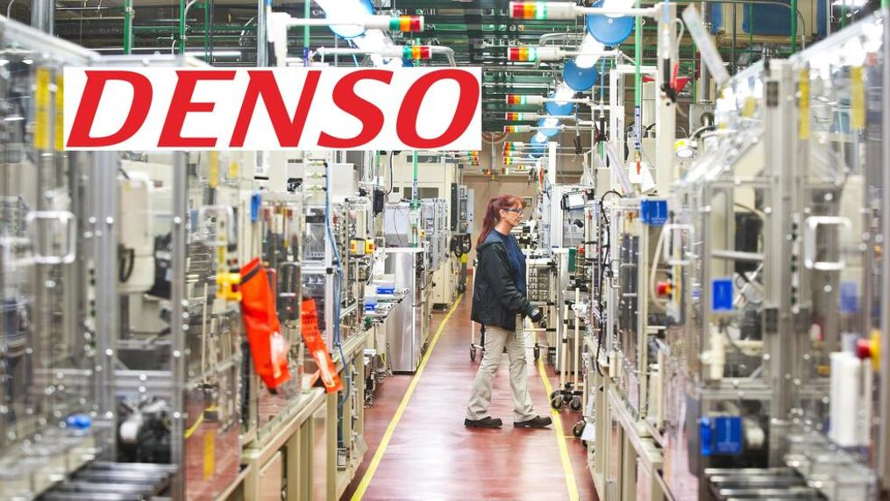
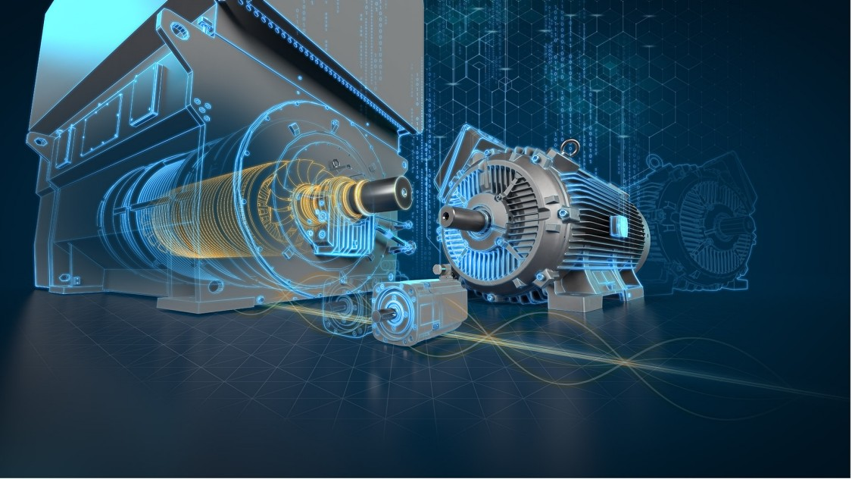











Who are we?
3
Notes:
A lot of what I will share today is based on work carried out by the Lingua Franca team which is an international group of researchers centered around
UC Berkeley, TU Dresden TU Kiel. NTNU in Norway, DTU in Denmark and Hanyang in Korea.

Slide 3
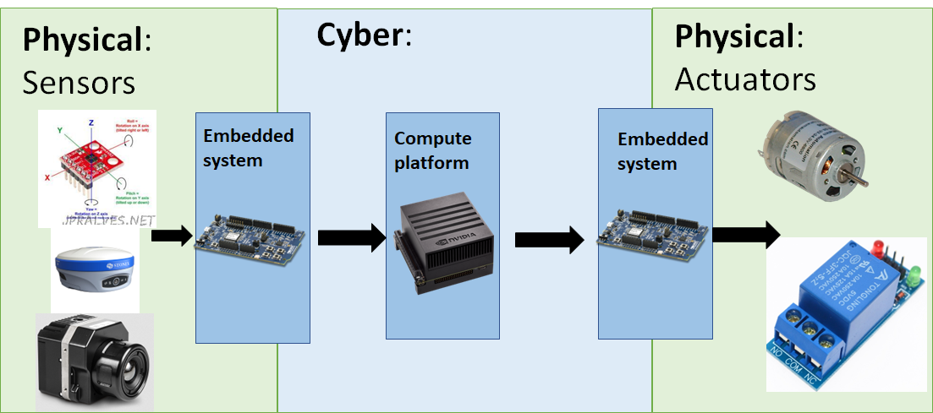
Where are embedded systems?
Notes:
Let start with a step back and look at what I mean by embedded systems software.
Interface between The real, continuous and messy physical world and the digital, discrete and algorithmic cyber world.
Its found at “both ends” at the input receiving measurements of the physical world through its sensors and at the output driving actuators

Slide 4
Two problems in embedded systems design
Concurrency is hard
Timing is hard
Notes:
Today I will focus on two challenges in embedded systems design. Concurrency and Timing

Slide 5
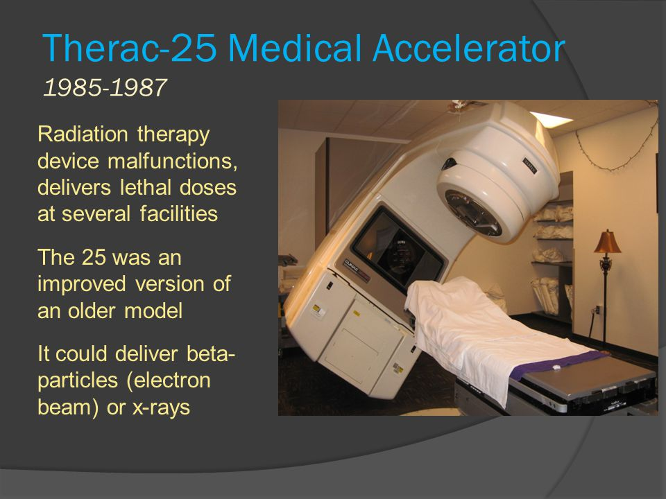
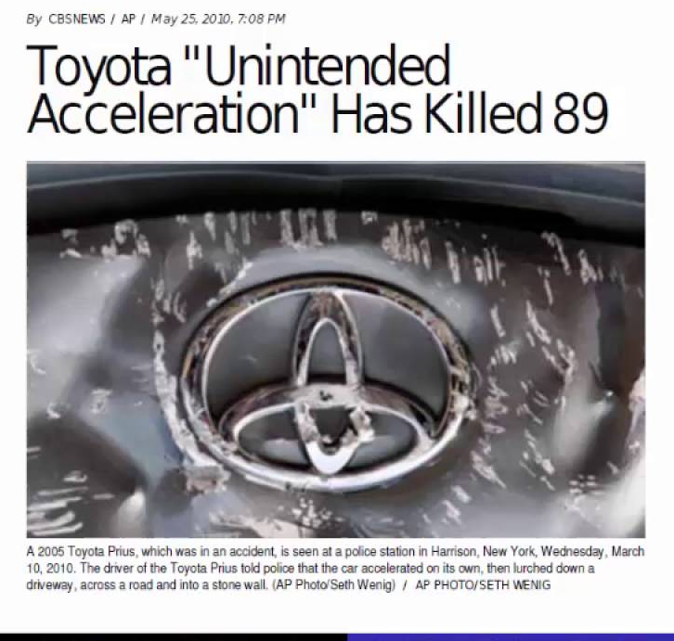
1. Concurrency is hard
Embedded systems are concurrent
Shared memory concurrency is a bad idea
Therac-25 and Toyota unintended acceleration
Notes:
Embedded systems are inherently concurrent.
Concurrency typically achieved through IRQs with callbacks, or more recently through threads of an RTOS.
These are both examples of concurrency model called “shared memory concurrency” and it is notoriously hard to “get right”
Here I am showing you two articles of very serious embedded systems concurrency bugs:
Therac-25 which delivered deadly doses of radiation
Toyotas unintended acceleration which had their cars accelerating for no reason
Both due to concurrency bugs which would not be possible in a higher-order concurrency model

Slide 6
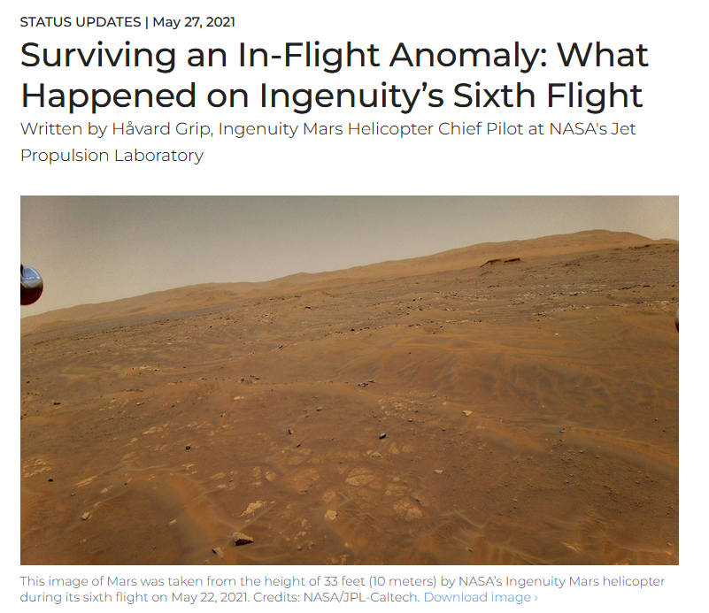
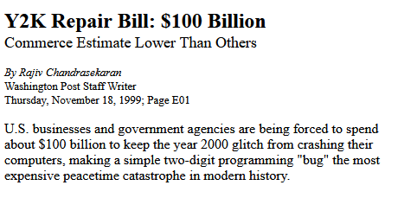
2. Time is hard
Accurate timestamping external events
Accurately generating external events
WCET and schedulability
Maintaining a logical timeline
Notes:
In real-time systems you can at-least thin about four problems related to time:
The ability to timestamp the ocurrence of external events (e.g. a PPS signal from a GNSS receiver)
The ability to generate an external event at a exact point in time (e.g. trigger a camera)
Reasoning about execution time of your programs to guarantee (2)
The maintaining of a logical timeline of your program.
On the right an article on the Mars Ingenuity helicopter that almost crashed during a flight at Mars because of a timestamping error.
On the left, the infamous Y2K problem where a lot of computer systems only used to decimal digits to represent the year which then wrapped in year 2000.
So subtle problems with real-life consequences

Slide 7
Lingua Franca: A solution to all this
Notes:
There are lots of proposed solutions to this, using models like Synchronous languages, Actor models or Communicating Sequential Processes, which I wont have the time to get into. Read the paper for a discussion on some of them.
I am here to talk about our proposed solution, the Lingua Franca language and the reactor model-of-computation

Slide 8
In a nutshell
“Lingua Franca is a polyglot, declarative, coordination language for concurrent, real-time (and distributed) systems”
Notes:
A mouthful

Slide 9
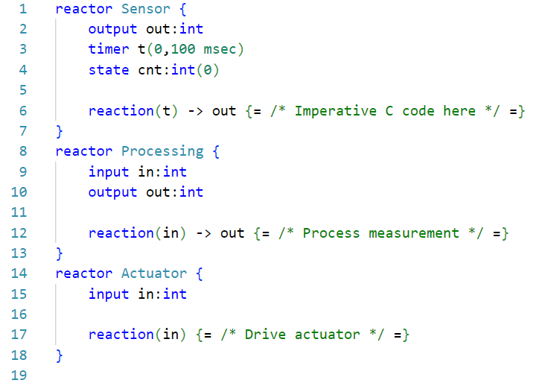
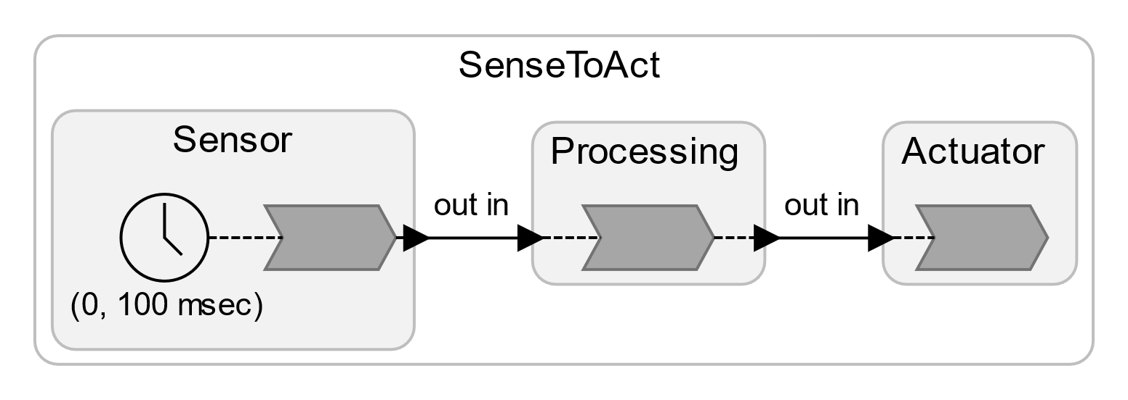
Show me code
Notes:
Coordination language: It separates the concerns of expressing computation from the concern of communication and scheduling. LF programs are all about expressing how snippets of imperative code in a target language should be scheduled.
Polyglot means that it supports target code in multiple languages like C, C++. Rust and Python. Today we are focusing on the C-target
Declarative, as opposed to imperative, meaning that the programmer expresses a program as a composition of message-passing reactors, and it is the compiler and runtime`s job to take advantage of inherent concurrency in that composition.
Enough words. Lets look at code
Here you see the declaration of three simple reactors, which are similar to classes in OO languages.
Reactors may encapsulate state, modes, and most importantly event-reactions which are snippets of imperative code written in a target language which is scheduled by the runtime.- Simulteanous reactions without data-dependencies may be execute in arbitrary order or in parallell on a multi-core system
Its the job of the runtime to use low-level synchronization primitives like locks and ensuring that program execution is deterministic.- In that sense LF separates the concerns of a programs coordination fabric, from its imperative code, i.e. actual computation
Reactors can be instantiated and connected to each other and communicate through message-passing which is modeled as time-tagged events carrying data
A LF program is compiled by LFC which code-generates an application which is linked with a runtime which then constitutes the program.

Slide 10
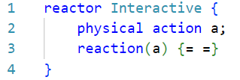
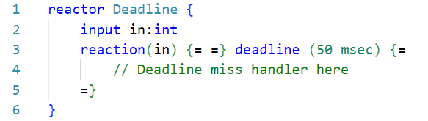
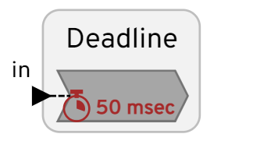
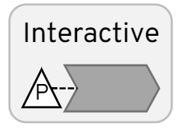
Interaction and real-time
Notes:
We also have language constructs for doing interaction with the external world through something called a physical action. It introduces non-determinism, but it is very explicit and contained.
Deadlines can be associated with reactions which is a portable way of specifying timing constraints which informs the run-time as to which reactions to prioritize.

Slide 11

Lingua Franca on embedded systems
Reactor 1
Reactor 2
Reactor 3
Reactor 4
Zephyr task 1
Zephyr task 2
LF C-runtime
LF Zephyr support
Zephyr Counter API
Zephyr kernel API
Reactor 2
Reactor 3
Reactor 4
Zephyr task 1
Zephyr task 2
Zephyr OS
Notes:
In this work we have added support for running LF programs ontop of the Zephyr RTOS. It could easily run bare-metal also, but Zephyr provides a nice abstraction and tooling which gives us fast access to hundreds of boards
As you see a LF program consisting of a set of reactors can execute together with Zephyr tasks running things like networking stacks etc

Slide 12
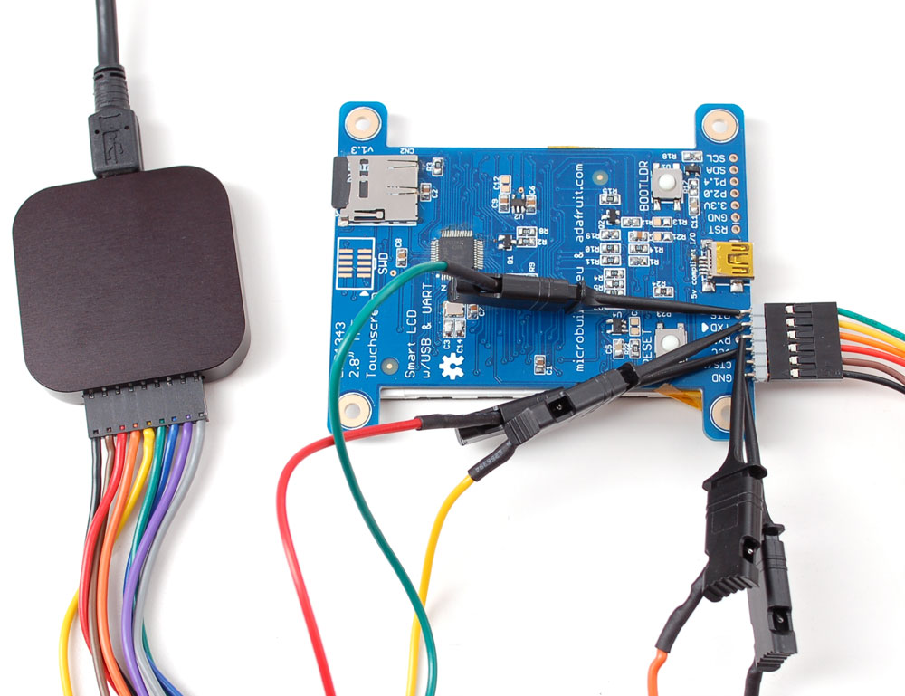
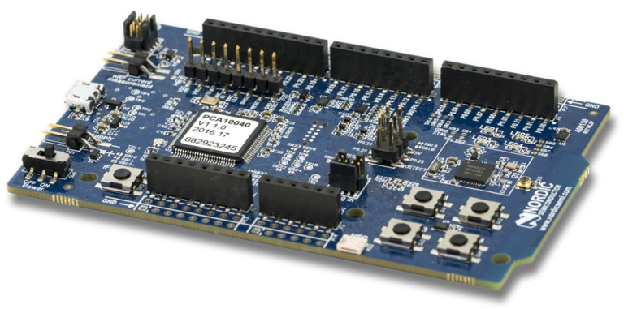
How to evaluate embedded systems frameworks
Average-case performance (Savina+ThreadMetric)
Time precision benchmarks (PWM generator)
Interrupt latency
Platform: nRF52 (64MHz)
Notes:
This paper is about evaluating the Lingua Franca runtime and demonstrate its applicability for real-time embedded systems
It does not seem to be an agreed upon set of benchmarks for evaluating the performance of a language or a framework for this use-case.
We propose a combination between: Average-case throughput/latency on different workloads Precision benchmarks Repeatability/Jitter benchmarks
We use logical analyzors to enable very accurate measurements of the timing of a program

Slide 13
Average-case performance
Notes:
First the average-case performance benchmarks.
Main take-away is that LF is competitive with just using threads. The overhead of switching between different reactions and advancing logical time is comparable to that of context switching between threads.
The message-passing overhead is also comparable to the overhead to message passing constructs like FIFOs and message queues in Zephyr.

Slide 14
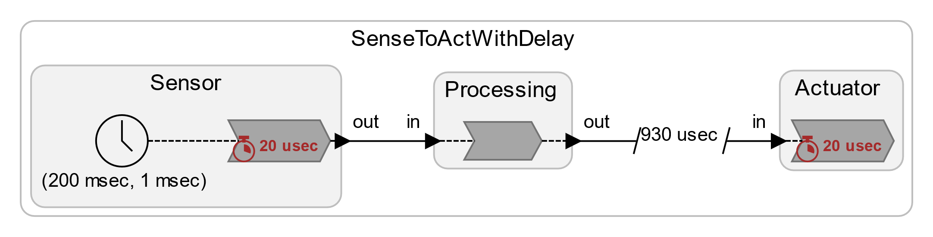
Precision at Sensor and Actuator
Sensor sampling offset
Actuator driving offset
Notes:
As to timing precision. Here are measurements of how accurately we are able to trigger reactions. So there are some constants offsets and a variance in the order of a microsecond. This is of course very sensitive to the platform you are evaluating it on. We are using NRF52 which is a 64MHz MCU with a 1MHz clock as time-source.

Slide 15
Interrupt timestamping precision and latency
Physical action timestamping precision
Physical action latency
Notes:
Here I show the precision and latency of which we can do non-deterministic interaction with the external world through these physical actions.
On the left is the precision of which a physical action is timestamped by the run-time.
On the right is the latency from a physical action schedule to a reaction triggered by the physical action is invoked.

Slide 16
Thank you
Web page: https://www.lf-lang.org/
Github: https://github.com/lf-lang/lingua-franca
Notes:
I think that’s all for now. Check out our web-page and Github and read the paper for more in-depth discussions.
Also come see me and Shaokai, the second-author which is also here today, after if you wanna talk more and maybe see a demo.
Thank you

